Slide 1



The SQL AI Workshop
aka.ms/sqlaiworkshop
Microsoft Azure Data
SQL
Bob Ward
Muazma Zahid
Davide Mauri
#azuresql
#sqlai

Slide 2
Workshop goals
Teach the fundamentals of GenAI
Teach others what we know
Assume SQL Server fundamental knowledge
Update your skills to the world of AI
Do it in 1 day
Present, demo, interact, do hands-on exercises
When possible don’t require an Azure subscription
Melt some brains

Slide 3






The Cloud Workshop for the SQL Professional
Module 1 GenAI Fundamentals
Module 5
Content Safety
Module 2 AI Models
Module 6
AI Frameworks
Module 3 Getting Started with SQL and AI
Module 7
Copilots
Module 4
RAG Patterns
Module 8
Microsoft Fabric
Use aka.ms/sqlaiworkshop for all lab instructions
Notes:
https://github.com/Azure-Samples/SQLAIWorkshop

Slide 4
Schedule for the day
9am – 10:00am
Introduction and Module 1
10:00am – 10:45am
Module 2
10:45am – 11:00am
Break
11:00am – 12:30pm
Modules 3 and 4
12:30pm – 1:30pm
Lunch
1:30pm – 2:45pm
Modules 5 and 6
2:45pm – 3:00pm
Break
3:00pm – 3:30pm
Module 6 Part 2
3:30pm – 4:45pm
Modules 7 and 8
4:45pm – 5pm
Wrap up, Resources, Q&A

Slide 5












Beyond RDBMS
https://aka.ms/sqldev
JSON and RegEx
Spatial
Graph
Columnstore
Memory-optimized
Ledger
Query Intelligence
REST API integrated
Data API Builder, GraphQL
Azure Functions
Hyperscale, Serverless, Pools
Containers, DevOps, GitHub
AI
Fabric
Notes:
Hand to Bob

Slide 6
This is a new moment for AI
1950s
Artificial Intelligence
the field of computer science that seeks to create intelligent machines that can replicate or exceed human intelligence.
Artificial Intelligence
Machine Learning
1959
Machine Learning
subset of AI that enables machines to learn from existing data and improve upon that data to make decisions or predictions.
Deep Learning
2017
Deep Learning
a machine learning technique in which layers of neural networks are used to process data and make decisions.
2021
Generative AI
create new written, visual, and auditory content given prompts or existing data.
Generative AI
Notes:
AI is a broad term which covers many different models.
It may seem as if we are entering a new era in AI, but several momentous milestones in the field have brought us to the inflection point we see today for the transformative potential of AI.
In 1950, Alan Turing invented the Turing Test to determine if a computer could pass for a human in written linguistic fluency.
Arthur Samuel (IBM) coined the term machine learning in 1959, however, its origins are rooted in theories of artificial intelligence.
In 2006, Geoffrey Hinton (University of Toronto) invented fast-learning algorithms and came up with the term “Deep Learning” to explain how AI-based on ML can learn like a human. However, the concept of deep learning existed far earlier (Widrow and Hoff introduced a neural network to reduce noise in phone lines in the late 1950s).
The Generative Adversarial Network (GAN) was introduced in 2014. GAN was created by Ian Goodfellow. With GAN, two neural networks play against each other in a game. The goal of the game is for one network to imitate a photo, and trick its opponent into believing it is real. The opponent is, of course, looking for flaws. The game is played until the near perfect photo tricks the opponent.

Slide 7





Why Generative AI and Your Data?
Get smarter with your data
Precise
Tailored
Faster
Intelligent
Interactive
Prompt sessions using natural language
Images created by Microsoft Copilot
Notes:
Precise – Get better and relevant answers to imprecise questions
Tailored – Find information that is tailored to a user or organization
Faster – Get information faster and more efficient
Intelligent – Get generated content that is more “than what you asked for” but relevant and helpful
Interactive – Use natural language to get information vs traditional searching methods

Slide 8





Let’s get grounded on prompts
Fine tuning = customizing a trained model
Grounding = providing additional context to a trained model
Prompt
+ search results
Prompt
Search results
Search
Generated
response
Language
Model
API
Prompt app
Retrieval Augmented
Generation (RAG)
Prompt Engineering
Better prompt = better responses
Notes:
In summary, prompt engineering bridges the gap between human language and machine learning models, enabling more accessible and intuitive interactions with LLMs¹²³.
Examples of prompt engineering
Instructions: provide directives to the LLM
Primary content: gives information to the LLM for processing
Examples: help condition the model to a particular task or process
Cues: direct the LLM's output in the right direction
Supporting content: represents supplemental information the LLM can use to generate output
Grounding a language model refers to the process of anchoring its responses in real-world context or knowledge
Microsoft Copilot uses a fine-tuned model called Prometheus based on GPT-4.

Slide 9




Building Generative AI applications with databases
Vectors and Embeddings
Databases and Indexes
Similarity and Hybrid Searches
Vectors and
Embeddings
Prompt
Prompt + search results
Generated
response
Generated response
Natural Language Chat
Retrieval Augmented
Generation (RAG) Application
Language
Model

Slide 10












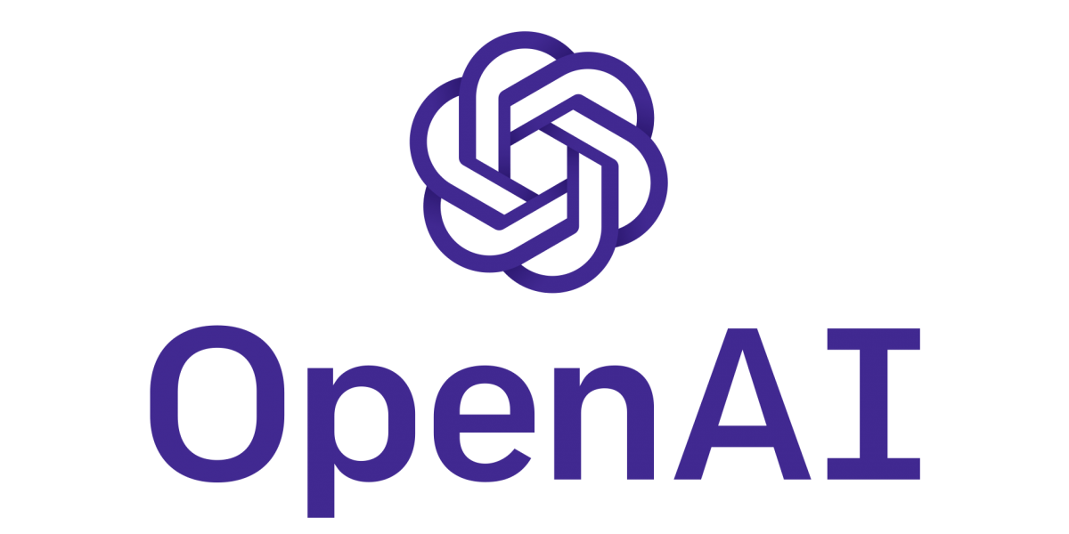











The AI developer platform
Applications and Users
AI Developer Tools and SDKs
Data
Azure AI Search Index
Azure
AI Studio
Microsoft
Copilot Studio
Entity
Framework
Semantic Kernel
LangChain
PyTorch
Your data
AI Models
Inferencing Endpoints
Vector Stores
GPT
Embedding
Llama
Azure
OpenAI
OpenAI
Hugging
Face
Ollama
Triton
NIM
KServe
vLLM
APIs in Azure Databases
Phi-3
Mistral
Hosts

Slide 11

Vectors and Embeddings
Feature Vector
Ordered array of numbers typically created by a human to train a model
[Height, Weight, Age, Fur Length, Energy Level]
“dog”
Embedding
Vector generated by a model that has semantic meaning
dog: [0.9, 0.3, 0.2, ...]
Image of a dog: [0.9, 0.3, 0.2, ...]
puppy: [0.88, 0.33, 0.21, ...]
“dog”
"I took the dog for a walk": [1.5, -0.8, 2.1, ...]

Slide 12
Similarity Searching using Cosine
Apple [10, 50]
Banana [12, 48]
1-cos() = 0.40 which is not similar
Dog [48, 12]
1-cos() = 0.99 which is similar
Cat [50, 10]

Slide 13
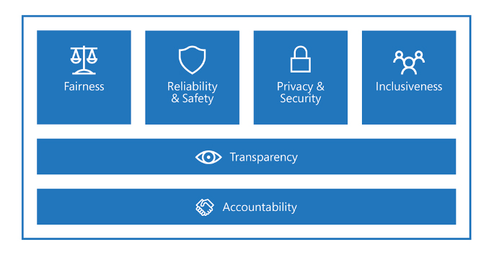
Responsible AI
aka.ms/msftresponsibleai
Notes:
Accountability
How can we create oversight so that humans can be accountable and in control?
Impact assessment
Oversight of significant adverse impacts
Fit for purpose
Data governance and management
Human oversight and control
Transparency
How might people misunderstand, misuse, or incorrectly estimate the capabilities of the system?
System intelligibility for decision making
Communication to stakeholders
Disclosure of AI interaction
Fairness
How might an AI system allocate opportunities, resources, or information in ways that are fair to the humans who use it?
Quality of service
Allocation of resources and opportunities
Minimization of stereotyping, demeaning, and erasing outputs
Reliability and Safety
How might the system function well for people across different use conditions and contexts, including ones it was not originally intended for?
Reliability and safety guidance
Failures and remediations
Ongoing monitoring, feedback, and evaluation
Private and Security
How might the system be designed to support privacy and security?
Privacy Standard compliance
Security Policy compliance
Inclusiveness
How might the system be designed to be inclusive of people of all abilities?
1. Accessibility Standards compliance

Slide 14
Knowledge check
Why should you use Generative AI with your data?
Inferencing endpoints have these advantages
​Interactive
​Precise
​Tailored
​Intelligent
​All of the above
​Use popular and latest AI models
​Load models directly into your app
​Ground to cloud
​A, C, and E
​You get to use Davide’s favorite models

Slide 15
Knowledge check
Retrieval Augmented Generation (RAG) is best described as…
What are embeddings?
​Fine tuning
​Grounding
​Deep Learning
​Vector Search
​A and B
​Feature vector
​Generated by an AI model
​Useful for semantic search
​B, C, and E
​Vectors based on text, images, audio

Slide 16
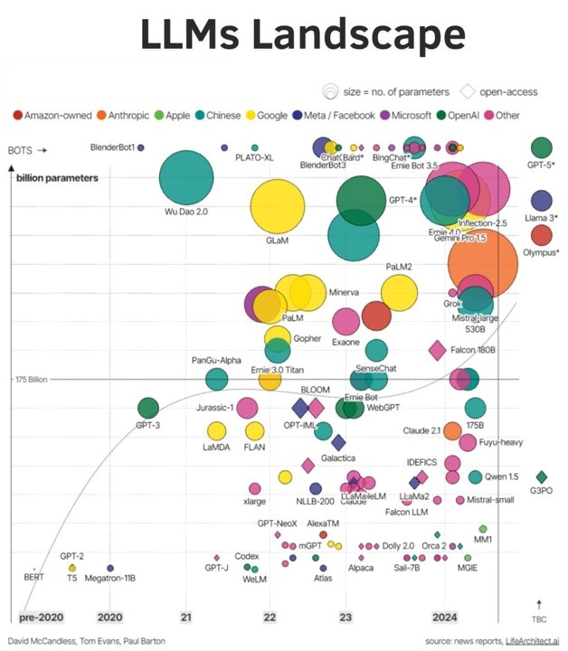
Models

Slide 17

Azure OpenAI Service https://learn.microsoft.com/en-us/azure/ai-services/openai/
Models | Description
o1-preview and o1-mini | Limited access models, specifically designed to tackle reasoning and problem-solving tasks with increased focus and capability.
GPT-4o & GPT-4o mini & GPT-4 Turbo | The latest most capable Azure OpenAI models with multimodal versions, which can accept both text and images as input.
GPT-4o audio | A GPT-4o model that supports low-latency, "speech in, speech out" conversational interactions.
GPT-4 | A set of models that improve on GPT-3.5 and can understand and generate natural language and code.
GPT-3.5 | A set of models that improve on GPT-3 and can understand and generate natural language and code.
Embeddings | A set of models that can convert text into numerical vector form to facilitate text similarity.
DALL-E | A series of models that can generate original images from natural language.
Whisper | A series of models in preview that can transcribe and translate speech to text.
Text to speech (Preview) | A series of models in preview that can synthesize text to speech.

Slide 18
Multi-Modal Models
Multimodal models (MM-LLMs) interact with technology by integrating multiple types of data, such as text, images, and audio, into a single model.
Microsoft's OmniParser: OmniParser uses two sequential models: 1. Object Detection: A fine-tuned YOLOv8 model detects interactable regions on a UI screen. This allows the Set of Marks approach, where a multimodal LLM like GPT-4V is fed a screenshot with bounding boxes marking these regions, rather than just the screenshot alone. 2. Image Captioning: A fine-tuned BLIP-2/Florence-2 model generates descriptions for each detected region. This way, GPT-4V receives not just the screenshot with marked regions, but also captions that explain the function of each region.

Slide 19
Multi-Modal Models
OpenAI GPT-4o: OpenAI's GPT-4o is optimized for performance and supports text and image processing. It accepts as input any combination of text, audio, image, and video and generates any combination of text, audio, and image outputs.

Slide 20
Prompts: Talking to a Model
𝗭𝗲𝗿𝗼-𝗦𝗵𝗼𝘁 𝗣𝗿𝗼𝗺𝗽𝘁𝘀 A zero-shot prompt tells the model: “Do the thing I want” Example of a Zero-Shot Prompt: Create a recipe for chocolate chip cookies. List all ingredients and steps. 𝗙𝗲𝘄-𝗦𝗵𝗼𝘁 𝗣𝗿𝗼𝗺𝗽𝘁𝘀 A few-shot prompt tells the model: “Do the thing I want, here are some examples, now do it” Example of a Few-Shot Prompt: Create a recipe for chocolate chip cookies. Here’s an example recipe for oatmeal raisin cookies .... Create the chocolate chip cookie recipe now, referencing the example for help, and list all ingredients and steps. 𝗖𝗵𝗮𝗶𝗻-𝗼𝗳-𝗧𝗵𝗼𝘂𝗴𝗵𝘁 (𝗖𝗼𝗧) 𝗣𝗿𝗼𝗺𝗽𝘁𝘀 In Chain-of-Thought (CoT) Prompts, you explicitly direct the model to reason before answering (and, if you are providing few-shot examples, you provide those with reasoning as well). Example of a CoT Prompt: Imagine you are creating a recipe for a dessert without any external resources. Think through the ingredients and steps before finalizing the recipe. Steps to create a recipe for chocolate chip cookies: - Think about common ingredients for cookies (flour, sugar, butter, etc.). - Consider the proportions needed for balance. - Plan the steps: mixing dry ingredients, creaming butter and sugar, adding eggs, combining all, and baking. Now, write the complete recipe for chocolate chip cookies with all ingredients and steps.

Slide 21
Prompts: Talking to a Model
𝗠𝘂𝗹𝘁𝗶-𝘁𝘂𝗿𝗻 𝗣𝗿𝗼𝗺𝗽𝘁𝘀 A multi-turn prompt involves a back-and-forth interaction where the model builds on previous responses. Example of a Multi-turn Prompt: User: How do I make chocolate chip cookies? AI: First, gather your ingredients: flour, sugar, butter, eggs, baking powder, salt, vanilla extract, and chocolate chips. User: Great, what’s the first step? AI: Preheat your oven to 350°F (175°C). In a bowl, mix flour, baking powder, and salt. 𝗥𝗲𝘁𝗿𝗶𝗲𝘃𝗮𝗹-𝗔𝘂𝗴𝗺𝗲𝗻𝘁𝗲𝗱 𝗚𝗲𝗻𝗲𝗿𝗮𝘁𝗶𝗼𝗻 (𝗥𝗔𝗚) 𝗣𝗿𝗼𝗺𝗽𝘁𝘀 RAG prompts involve retrieving information from a database or document to help generate a response. Example of RAG Prompt: Using the provided document on baking techniques, answer the following question: What are the best practices for making chewy chocolate chip cookies?

Slide 22

Prompts: Formatting
Language Models need very explicit instructions to complete tasks successfully.
You are an experienced [Specify a role],
I need a [What is your final goal?],
You will [Enter a task],
In the process, you should [Enter details],
Please exclude [Enter exclusion],
Output the final result as a [Select a format],
Here is an example: [Enter an example]
Notes:
Buck

Slide 23
Prompts: Examples
Leverage the Pareto Principle for learning Prompt: "Identify the 20% of <topic> that will yield 80% of the desired results and provide a focused learning plan to master it."
Utilize the Feynman Technique for deeper understanding Prompt: "Explain <topic> in the simplest terms possible as if teaching it to a complete beginner. Identify gaps in my understanding and suggest resources to fill them."
Optimize learning through interleaving Prompt: "Create a study plan that mixes different topics or skills within <topic> to help me develop a more robust understanding and facilitate connections between them."
Implement spaced repetition for long-term retention Prompt: "Design a spaced repetition schedule for me to effectively review <topic> over time, ensuring better retention and recall."
Notes:
Buck

Slide 24
Prompts: Examples
Develop mental models for complex concepts Prompt: "Help me create mental models or analogies to better understand and remember key concepts in <topic>."
Experiment with different learning modalities Prompt: "Suggest various learning resources (e.g., videos, books, podcasts, interactive exercises) for <topic> that cater to different learning styles."
Harness the power of active recall Prompt: "Provide me with a series of challenging questions or problems related to <topic> to test my understanding and improve long-term retention."
Use storytelling to enhance memory and comprehension Prompt: "Transform key concepts or lessons from <topic> into engaging stories or narratives to help me better remember and understand the material."
Notes:
Buck

Slide 25

Demo Diving into AI Models

Slide 26

Hands-on Walkthrough
aka.ms/sqlailive

Slide 27
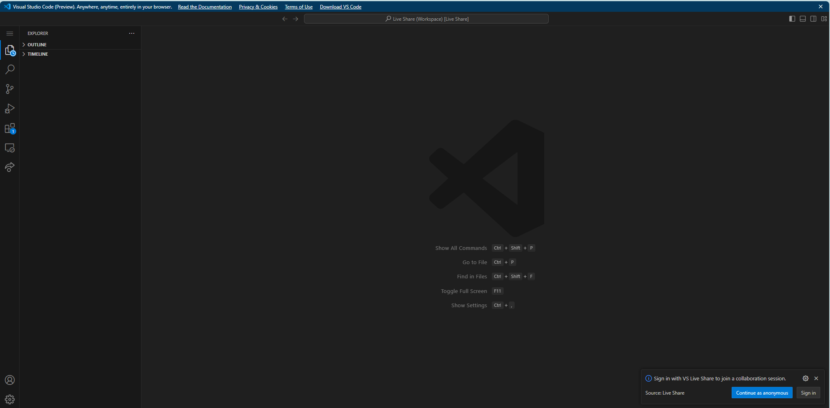

Slide 28
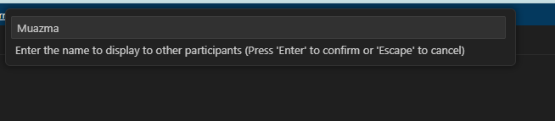
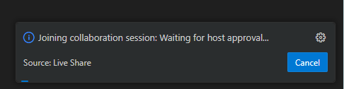
Type your name
Wait for Approval

Slide 29
Notebook
AIModels.ipynb

Slide 30
Knowledge check
What is an advantage of using Azure OpenAI?
What is a multi-turn prompt?
​Scalability, global access, Azure security
​Access to different types of models
​Use latest OpenAI innovation
​Azure compliance and regulation
​All of the above
​Fine tuning an AI model
​A few-shot prompt
​Prompts based on previous responses
​A and C
​Using chat feedback for better prompts

Slide 31





Why SQL for AI apps?
Security
Familiarity
Reliability
Integrated
Scalability

Slide 32
Why SQL for AI apps?
Security
Familiarity
Reliability
Integrated
Scalability

Slide 33



Azure SQL Database and AI Scenarios
aka.ms/sqlai
aka.ms/sqlaisamples
Prompt Engineering and Retrieval Augmented Generation (RAG)
Use AI Services
Connected to SQL
Use frameworks
Connected to SQL or AI
Use T-SQL for Hybrid Search
Connected to AI
Index with Azure AI Search
Vector Search with Azure OpenAI
NL to generate SQL
Orchestrate GenAI apps
Store vectors in SQL Invoke Models using REST API
What about chat history?
Where do you store your text data?

Slide 34






Get smarter with your SQL data
Data Source
Apply skills
Embeddings PII
Azure AI
Search
Extract and build
Prompt
Response
Search and results
Application
(Web app or Copilot)
Azure OpenAI Service
Incremental
changes
Index

Slide 35

Demo Vector Search and Chat with your Data using Azure AI services

Slide 36
Let’s REST a bit
REpresentational State Transfer is an API using the HTTP protocol
Client/Server
Stateless
Cache
Uniform interface
Layered system
Code on demand
Notes:
Client/Server – Client are separated from servers by a well-defined interface
Stateless – A specific client does not consume server storage when the client is "at rest"
Cache – Responses indicate their own cacheability
Uniform interface
Layered system – A client cannot ordinarily tell whether it is connected directly to the end server, or to an intermediary along the way
Code on demand (optional) – Servers are able to temporarily extend or customize the functionality of a client by transferring logic to the client that can be executed within a standard virtual machine

Slide 37

REST and Inferencing Endpoints
Azure OpenAI REST
Embeddings
{ "input": [ "this is a test" ] }
{ "body": { "data":
[ { "index": 0, "embedding": [ <number>, … ] }}}-
GPT
Embedding
Llama
Chat Completions
Phi-3
Mistral
[
{"role": "system", "content": "You are a helpful assistant."},
{"role": "user", "content": "Who founded Microsoft?"}
]
[
{"role": "assistant", "content": "Microsoft was founded by Bill Gates and Paul Allen."}
]

Slide 38











Azure SQL Database External REST endpoints
Integrate with ML and OpenAI
Integrate with everything JSON
Send events
sp_invoke_external_rest_endpoint
Bring your own REST APIs
EXECUTE ANY EXTERNAL ENDPOINT
Integrate with Azure Storage, text, and XML

Slide 39
Call REST services from the Azure SQL Database
declare @url nvarchar(4000) = N'https://skynetbeta.openai.azure.com/openai/deployments/chattykathy/chat/completions?api-version=2023-07-01-preview';
declare @headers nvarchar(102) = N'{"api-key":"1001001sos1001001indistress"}'
declare @payload nvarchar(max) = N'{"messages":[{"role":"system","content":"You are an AI assistant that helps people find information."},{"role":"system","content":"Why is the sky blue?"}]}'
declare @ret int, @response nvarchar(max);
exec @ret = sp_invoke_external_rest_endpoint
@url = @url,
@method = 'POST',
@headers = @headers,
@payload = @payload,
@response = @response output;
select @ret as ReturnCode, @response as Response;

Slide 40





Use T-SQL for Vector and Hybrid Search Connected to AI
Create
embeddings
Prompt
Generate
embedding
Vector
Search
Create embedding with new rows
Update embedding for any change
Existing data

Slide 41
Knowledge check
Why can SQL be great for AI apps?
What are scenarios for SQL and AI?
​Security
​Familiarity
​Scalability
​Reliability
​All of the above
​Use AI services
​Load models directly into your app
​Ground to cloud
​A, C, and E
​You get to use Davide’s favorite models

Slide 42
Knowledge check
Why use Azure AI Services and SQL?
How can you use T-SQL for a vector search?
​Low code solution
​Easily integrate with Azure OpenAI
​Use T-SQL vector search
​Ultimate control
​A and B
​Use an Azure AI Search Index
​Use frameworks
​Use T-SQL for hybrid search
​A, B, and C
​Full-text search

Slide 43
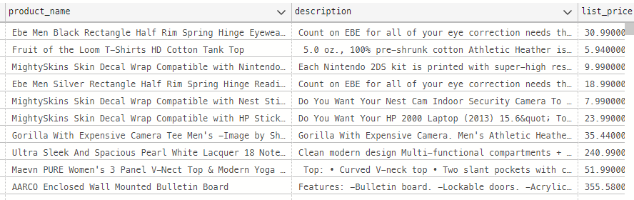
Let’s start from a simple “Products” table
How AI can help here?

Slide 44
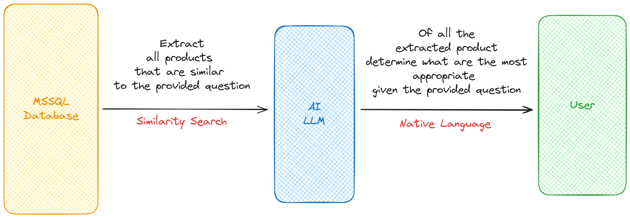
RAG (Retrieval Augmented Generation) Pattern
Key feature: VECTORS
Key feature: MODELS

Slide 45
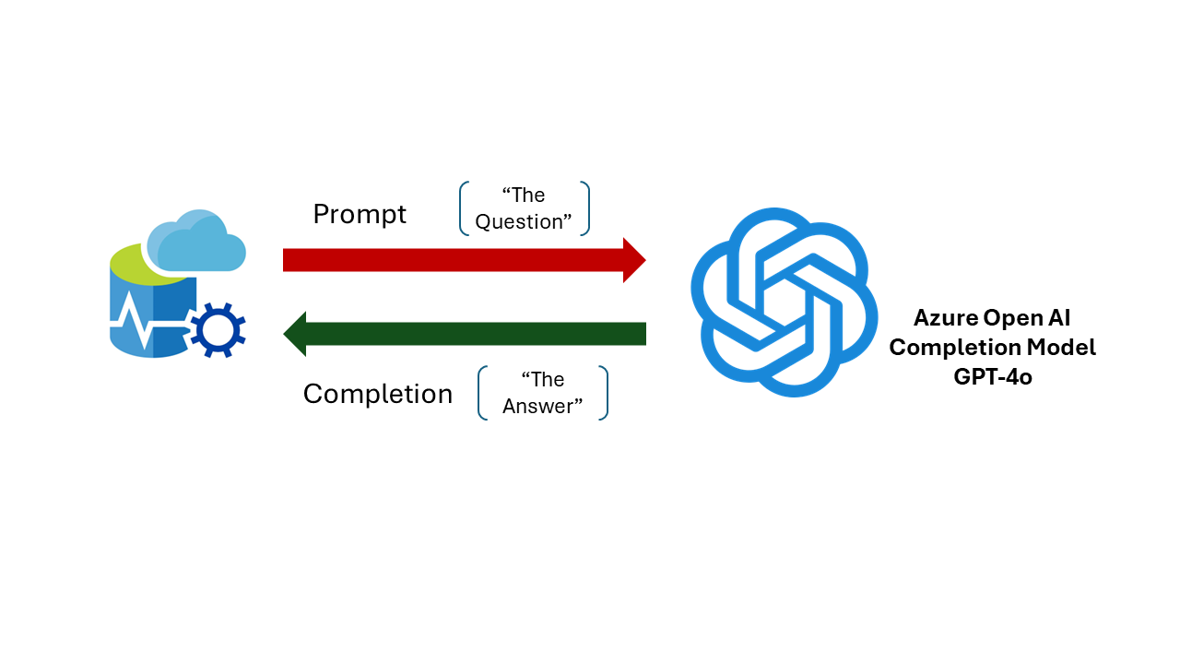

Slide 46
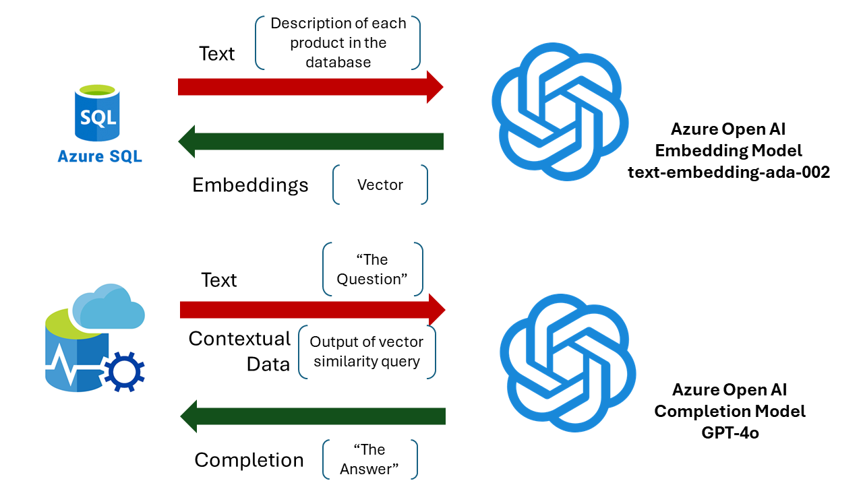

Slide 47

Demo RAG Patterns with SQL
Notes:
Intro to embeddings
Create Embeddings with External REST Endpoint Invocation
Vector and Filter Search
RAG

Slide 48
Hands-on Lab
Create Embeddings with External REST Endpoint Invocation
Vector and Filter Search
RAG
OpenAI DALL·E 3 and GPT-4o model
Use aka.ms/sqlaiworkshop for all lab instructions

Slide 49
Let’s get started
Prerequisites, you need one of these tools to connect to Azure SQL Database
SSMS or
Azure Data Studio or
Visual Studio Code with mssql extension

Slide 50
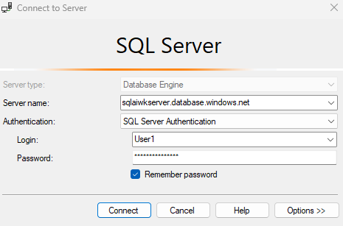
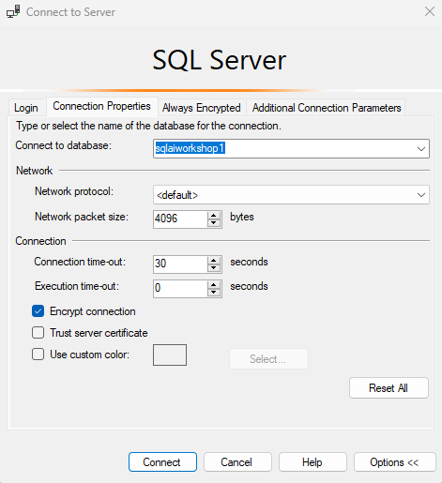
SSMS Connect to pre-created Azure SQL DB

Slide 51
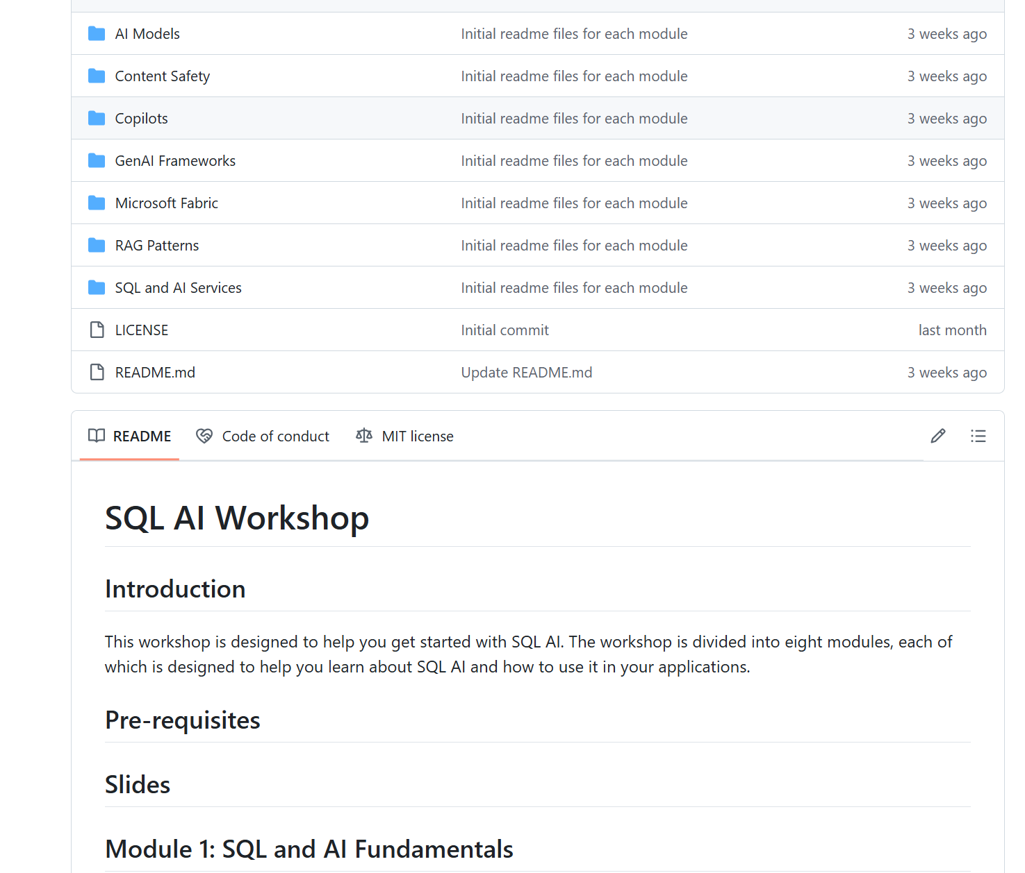
GitHub aka.ms/sqlaiworkshop
Use aka.ms/sqlaiworkshop for all lab instructions

Slide 52
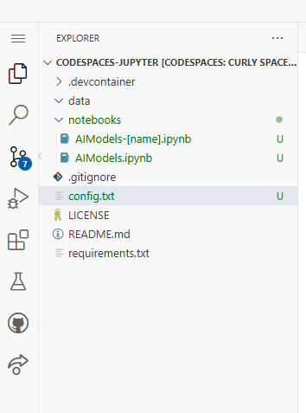
API keys
In the config.txt
[AI Models Codespaces]
Use aka.ms/sqlaiworkshop for all lab instructions

Slide 53
RAG - FAQ
How do I generate embeddings?
How do I keep embeddings updated?
Which embedding model should I use?
Can I generate embeddings only on text?
Which distance metric should I use for better answers?
If I have a lot of data, will performance be good enough?

Slide 54
Lunch Break

Slide 55
Knowledge check
What are the two steps to build a RAG pattern?
What SQL features are needed to build a RAG pattern?
​LLM training
​Create a feature vector
​Prompt engineering
​Vectorization of data
​C and D
​sp_invoke_external_rest_endpoint
​vector type
​vector search
​A, B, and C
​JSON type

Slide 56

Azure AI Content Safety https://learn.microsoft.com/en-us/azure/ai-services/content-safety/
AI Content Safety Feature | Description
Analyze text API | Scans text for sexual content, violence, hate, and self harm with multi-severity levels.
Analyze image API | Scans images for sexual content, violence, hate, and self harm with multi-severity levels.
Prompt Shields (preview) | Scans text for the risk of a User input attack on a Large Language Model.
Groundedness detection (preview) | Detects whether the text responses of large language models (LLMs) are grounded in the source materials provided by the users.
Protected material text detection (preview) | Scans AI-generated text for known text content (for example, song lyrics, articles, recipes, selected web content).

Slide 57

Azure AI Language https://learn.microsoft.com/en-us/azure/ai-services/language-service/
AI Language Feature | Description
Personally identifying (PII) and health (PHI) information detection | PII detection is a preconfigured feature that identifies, categorizes, and redacts sensitive information in both unstructured text documents, and conversation transcripts. For example: phone numbers, email addresses, forms of identification, and more.
Language detection | Language detection is a preconfigured feature that can detect the language a document is written in and returns a language code for a wide range of languages, variants, dialects, and some regional/cultural languages.
Sentiment Analysis and opinion mining | Sentiment analysis and opinion mining are preconfigured features that help you find out what people think of your brand or topic by mining text for clues about positive or negative sentiment and can associate them with specific aspects of the text.
Summarization | Summarization is a preconfigured feature that uses extractive text summarization to produce a summary of documents and conversation transcriptions. It extracts sentences that collectively represent the most important or relevant information within the original content.
Key phrase extraction | Key phrase extraction is a preconfigured feature that evaluates and returns the main concepts in unstructured text and returns them as a list.
Entity linking | Entity linking is a preconfigured feature that disambiguates the identity of entities (words or phrases) found in unstructured text and returns links to Wikipedia.
Notes:
Additional exercise: Tie PII to RAG

Slide 58

Demo AI and Content Moderation

Slide 59
Hands-on Lab
Content Safety
PII Entity Recognition
Use aka.ms/sqlaiworkshop for all lab instructions

Slide 60
Knowledge check
What type of features can content safety support?
What attributes make up a content safety score?
​Prompt shields
​Analyze text and data
​Groundedness detection
​PII detection
​All of the above
​Hate
​Self-harm
​A, B, and E
​Pick Bob’s favorite sports team
​Violence

Slide 61


Semantic Kernel
Azure SQL connector
Vector Store
Notes:
Now you can use LangChain and Semantic Kernel to store embeddings in Azure SQL database thank to this connecter we’ve working on.
Tight integration with LangChain and Semantic Kernel

Slide 62
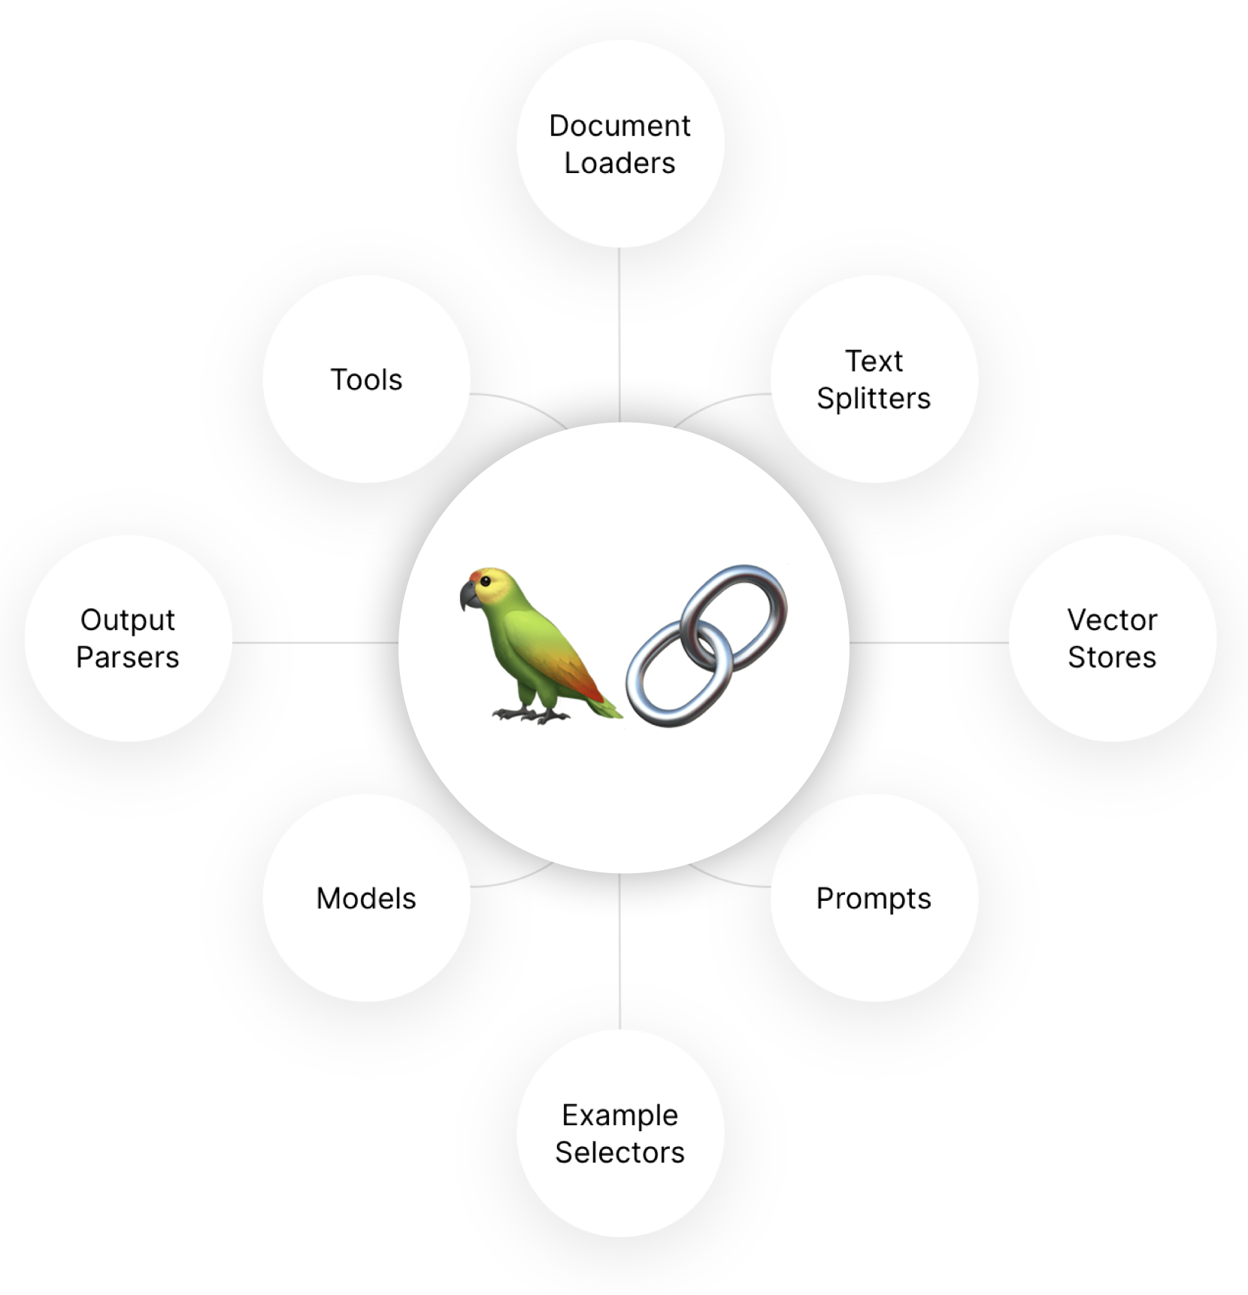
LangChain https://www.langchain.com/
LangChain is an open-source framework designed to simplify the development of applications that integrate with large language models (LLMs). It provides tools and abstractions to manage the complexities of working with LLMs, such as prompt engineering, chaining multiple LLM calls, and integrating with external data sources. LangChain aims to make it easier for developers to build powerful, language-driven applications with minimal effort.
Notes:
Notebook: publish result and walkthrough

Slide 63
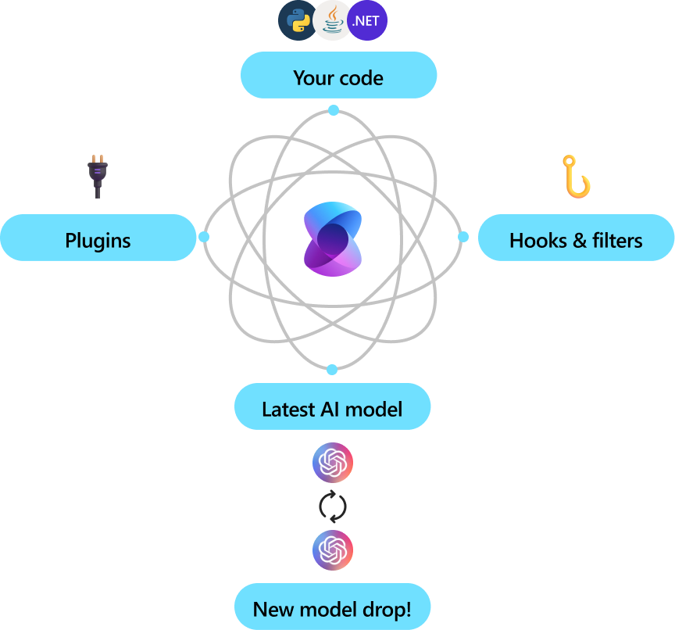
Semantic Kernel https://github.com/microsoft/semantic-kernel
Semantic Kernel is an open-source project by Microsoft that focuses on enabling developers to build AI applications using semantic search and natural language understanding. It provides a set of tools and libraries to create, train, and deploy AI models that can understand and generate human language. Semantic Kernel is designed to be highly extensible and integrates seamlessly with other Microsoft AI services, making it a versatile choice for building intelligent applications.

Slide 64
Building scalable AI applications
Semantic Search
RAG Pattern
Store vectors and data together for consistency and Search for most relevant data
Retrieve the most semantically relevant data from your database and use it to ground LLMs for specific scenarios.
Structured Queries
Allow LLMs to query structured data and take advantage of rich metadata and query optimization
Notes:
RAG is not AI! There is much more to that.

Slide 65

Demo GenAI Frameworks
Notes:
https://github.com/Azure-Samples/azure-sql-db-rag-langchain-chainlit
https://github.com/Azure-Samples/azure-sql-db-chat-sk

Slide 66
Hands-on Walkthrough
aka.ms/sqlailive

Slide 67
Chat History, Bot Memories

Slide 68




The Age of Copilots
aka.ms/msftcopilots
AI for everything you do
Leveraging Large Language Models (LLMs)
for natural language understanding and response generation.
Microsoft Copilot
Microsoft Copilot for Azure
Microsoft Copilot for Microsoft 365
Microsoft Copilot for Security
Copilot in Windows
Copilot in Fabric

Slide 69

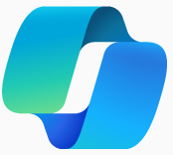
Simplify development, design, operations, and troubleshooting
Microsoft Copilot experiences for SQL
GitHub Copilot for inline code generation, assistance, and chat
Microsoft Copilot for Azure helps design, operate, optimize, and troubleshoot
Copilot in Azure SQL Database for self-assistance and T-SQL code generation

Slide 70
Demo Microsoft Copilot in Azure

Slide 71



Our vision for SQL
Simplifying Database Management with AI
Improve efficiency
Design and optimize
Simplify
Performance
Security
Availability
Disaster Recovery
Database schemas
Correct and performant SQL
Enable data-driven applications
Manage
Databases
Navigate complexity of SQL
Maximize use of Azure

Slide 72
Azure SQL Database Copilot portal experiences
Microsoft Copilot in Azure + Azure SQL skills
Assists with several Azure SQL capabilities including database insights, best practices, database management, and troubleshooting common issues.
Natural Language to SQL in Azure SQL Query editor (preview)
Input a natural language question and receive a T-SQL query suggestion.

Slide 73
Copilot principles
Responses are grounded in your Azure SQL Database environment.
Copilot only has access to resources that YOU have access to and can only perform analysis and actions that you have the permissions to perform.
User-provided prompts and responses are NOT used to further train, retrain, or improve Azure OpenAI Service foundation models.
Notes:
2 minutes
Data, privacy, and security for Azure OpenAI Service - Azure AI services | Microsoft Learn

Slide 74
Microsoft Copilot in Azure
AI-Powered Assistant: Copilot for Azure is an AI companion that simplifies how you design, operate, optimize, and troubleshoot apps and infrastructure from cloud to edge.
Open Preview Access announced at BUILD: Rolled out to all customers, with options to enable or disable for specific Azure tenants.
Enhanced Azure SQL Capabilities: New features for Azure SQL Database to improve the management of SQL-dependent applications.
Today’s Focus
Notes:
1 minute

Slide 75
Example prompts
aka.ms/sqlcopilot has 51 skill examples
Topic | Example Prompts
Active User Connections | Who are currently actively connected to the database?
Blocking Session Analysis | Check top blocking sessions.
Database and Table Size | What's the size of this database?
Database Performance Analysis | Why is my database slow?
Deadlock Analysis | Why am I getting deadlock errors? How can I fix it?
Fragmented Index Analysis | Help me find fragmented indexes.
Index Recommendations | Should I add an index on this table?
Missing Index Suggestions | Missing index suggestion for improving query performance?
Point-in-Time Restore Retention | How far back in time can I go for a point-in-time restore?
Query Store - Longest Running Queries | What are the longest running queries in the past day?
Query Store - Queries with Multiple Plans | Queries that have had more than one execution plan.
Related Documentation | What does database compatibility level mean?
Resource Usage Analysis | Is the database hitting resource limits? Which limits?
Wait Statistics Analysis | What do the wait statistics look like for my database?
We have several skills in the roadmap (index tuning, best practices, and much more)
Notes:
1 minute
Bob and Joe conversation – how does this all work?

Slide 76

Data flow
Prompts and answers are NOT stored at any point
SQL skill stores *only* telemetry needed to assess system health
Results are evaluated for security and safety before presented to customer
SQL skill sends results to Azure Copilot for final result assembly
Azure Copilot orchestrator identifies SQL skill as best match for prompt and sends request along
Azure Copilot leverages DMV’s and Query Store from customer’s SQL database
Customer sends question to Copilot through Azure Portal
SQL skill sends prompt to LLM to identify intent
SQL skill leverages data from internal support systems to help answer the question
Notes:
3 minutes (6 minutes if we take audience questions)
Bob to ask Joe questions and questions from audience.

Slide 77
Usage Tips
Context matters. Copilot Azure SQL prompts are most effective when asked within the specific database blade context.
Note: Recently we changed the experience to still help with general Q&A outside of a specific database blade.
Speed varies based on the task. Some prompts, like database fragmentation checks, may take longer.
No database configuration changes. For Azure SQL Database questions, Copilot provides information and instructions but won't make configuration changes.
Use where you need help. Copilot doesn’t replace other methods. If you have a preferred efficient way to do something, you should keep doing it…

Slide 78
Demo “SQL Copilot”

Slide 79
Natural language to SQL (preview)
Azure portal Query editor is a browser-based tool for light querying + exploration
We’re adding a natural language to SQL experience
Generates T-SQL queries based on natural language input
Uses Large Language Models (LLMs) from Azure OpenAI
+ Table schema
+ primary and foreign key constraints

Slide 80
Natural Language to SQL – Usage Tips
Schema and relationships help with generation. NL2SQL uses the following based on user permissions:
Table and view schema definition
Note: we’ll be adding additional context such as NULLability and data types
PK\FK relationships
Expressive names result in the most effective generation. NL2SQL relies on meaningful and descriptive table and column names.
Roadmap: We are looking into ways to improve accuracy through additional customer-provided context. For example, ability to share “hints” on naming conventions or example prompt\query pairs.

Slide 81
Demo NL2SQL

Slide 82
FAQs…
How much will it cost?
No charge right now, but there will be announcements leading up to Azure Copilot General Availability.
What Azure SQL Database offerings are supported in preview?
General Purpose, Business Critical, Hyperscale, DTU-based Standard and Premium, Serverless, and Elastic pools.
What about Copilots for other SQL offerings?
We expect opportunities for Copilots across the SQL portfolio. Stay tuned!
How do I enable or disable Copilot?
Manage by following these instructions: aka.ms\sqlcopilot-manage-access

Slide 83
What have we learned so far?
A balance of Quality, Depth, and Speed. Finding the right balance between quality responses, depth, and speed is critical – with needs varying by persona and role.
Overriding LLM Myths is sometimes necessary. Some LLM knowledge needs correction. Example: SPID > 50 misconception. Trained on public databases (AdventureWorks, Northwind).
Form Factor Matters. Flexible interfaces are needed for complex result sets.
Feedback is Essential. Thumbs-down without details makes it hard to improve.
Without the original prompt/response, we can’t pinpoint issues.

Slide 84
Learn more and provide feedback
aka.ms/bobwardms
Azure Copilot and Azure SQL: https://aka.ms/sqlcopilot
Please provide feedback in the portal (thumbs up \ down, comments describing experience)
Natural language to SQL: https://aka.ms/sqlcopilot-nl2sql
Other ideas? Email our team: sqlcopilotpreview@microsoft.com

Slide 85
Knowledge check
SQL Copilot experiences include
AI Assistants that can be used for SQL include
​Self-help for common SQL problems
​NL2SQL
​Natural language prompts in Azure Portal
​A, B, and C
​Connect to model of your choice
​GitHub Copilot
​Copilot in Azure
​Copilots in Microsoft Fabric
​Microsoft Bob Pilot
​A, B, and C

Slide 86
Knowledge check
Azure SQL Database Copilot has permissions based on
NL2SQL uses the following resources
​Owner of the Azure subscription
​sysadmin of the Azure SQL Database
​User logged into the Azure Portal
​Contributors in the resource group
​B and C
​Natural language prompt
​Azure OpenAI language model
​Schema of database tables
​Existing model knowledge of SQL
​All of the above

Slide 87









Microsoft Fabric
Unified data platform for the era of AI
Data Factory
Data Engineering
Data Warehouse
Data Science
Real-Time Intelligence
Power BI
AI
OneLake
Purview
Notes:
I often like to compare Microsoft Fabric to Microsoft Office – Office is a suite of productivity tools such as Word, PowerPoint, Excel. Each optimized for a particular task, building a spreadsheet or writing a document. But the applications in Office share common elements – whether it’s the user experience, how you spell check or copy & paste or format text. But also at the foundational layer – how you govern the applications in Office, how you store and collaborate on files.
Think of Microsoft Fabric in the same way, it’s a suite of analytics tools. Whether that’s for integrating your data, building a data warehouse, or analyzing your data in Power BI. Each of the tools in Microsoft Fabric share common elements – how you connect to data, how you manage artifacts in workspaces, how you move from dev to test to production
But also they share the foundational layers of the Fabric Platform. How you manage security and compliance centrally, How you store and collaborate on data, how you govern the entire platform.

Slide 88









Mirroring Databases
Supercharge analytics time to value
Mirroring replicates databases to Fabric with zero ETL
Compute replication is included with your Fabric capacity for zero cost.
Free storage costs based on Fabric capacity
Data is replicated into One Lake and kept up-to-date in near real-time
Mirroring protects operational databases from analytical queries
Data
Factory
Data
Engineering
Data
Science
Data Warehouse
Real Time Intelligence
Power BI
Data Activator
Serverless Compute
Spark
T-SQL
KQL
Analysis Services
OneLake
Customers 360
Finance
Service Telemetry
Business KPIs
Delta – Parquet Format
Azure SQL DB
Azure Cosmos DB
Notes:
Mirroring in Fabric is an intuitive, zero-cost and low-latency solution to bring data from Azure SQL Database, Azure Cosmos DB, and Snowflake together into Fabric. You can continuously replicate your existing data estate directly into Fabric's OneLake
With the most up-to-date data in a queryable format in OneLake, you can now use all the different services in Fabric, such as running analytics with Spark, executing notebooks, data engineering, visualizing through Power BI Reports, and more.
Enabling Mirroring in Fabric is simple without having the need to create any more complex ETL pipelines, allocate other compute resources, and manage data movement.
Mirroring in Fabric is a fully managed service, so you don't have to worry about hosting, maintaining, or managing replication of the mirrored connection.

Slide 89


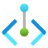

Azure
Fabric
External live database
SQL analytics endpoint item
Source Azure SQL Database
Mirrored database item
Read-only for analytics
Near real-time
Incremental replication inserts/updates/deletes
Delta Parquet in OneLake
Source SQL Server Database
Data Warehouse
Fabric Lakehouse
Power BI
Fabric Spark
OneLake
Private Preview

Slide 90

Demo Mirroring SQL ground to cloud in Microsoft Fabric

Slide 91




You have questions
What other questions do you have?
What’s the change data latency for mirroring?
What is the difference between Mirroring & Azure Synapse Link for SQL?
Do we only publish committed transactions?
What is mirroring’s transactional consistency?
Notes:
Latency: Post snapshot, no latency observed (for incremental changes perspective). This means once the snapshot was generated incremental changes were available instantaneously in OneLake storage for processing to Delta parquet. Observation – when user workload is less than 70% CPU, minimal degradation in TPS is observed during the snapshot and no degradation in TPS was observed post snapshot. If customer’s workload is around 80-90% CPU and they want to enable Fabric mirroring, then customer should consider upgrading to higher SLO or enable fabric mirroring during low peak period.

Slide 92

Fabric Experiences Unlocked with Mirroring
Data Warehouse
Lakehouse
Data Science & ML
Power BI
Powered by CoPilot,
T-SQL, Spark engines and more

Slide 93

Demo: Mirrored Azure SQL data with Microsoft Fabric Experiences

Slide 94
Knowledge check
The benefits of Fabric Mirroring are
How does Fabric mirroring capture changes?
​Near-real time analytics
​SQL endpoint for queries
​Build PowerBI reports easily
​Free OneLake storage
​All of the above
​Poll database tables
​Export using Polybase
​Changes read from the transaction log
​B and C
​SQL Server Replication

Slide 95
Gen AI Uses Cases
Chat with your Data
Build AI Assistant
Document processing and Summarization
Content Generation
Personalized Recommendations
Customer Experience
Code Generation and Documentation
Fraud Detection
Knowledge Mining
……

Slide 96
SQL + AI Use Cases
What
Why
When
a
Drastically reduces latency
Saves on Token consumption
Reduces costs and latency for LLM
Semantic Caching
Slow moving / static content
FAQs, Policies…
Conversational context
UX improvements
LLM optimizations
Auditing
Chat History
Chat sessions
Improving cost & performance
Retrieval Augmented Generation (RAG)
Personalize LLM on your data
Cheaper than fine tuning
Faster iteration on new data
Any workload for GenAI apps
Vector + Operational Database
No ETL
Consistent data
Reduce complexity & costs
Data & vectors together
Scale & performance

Slide 97
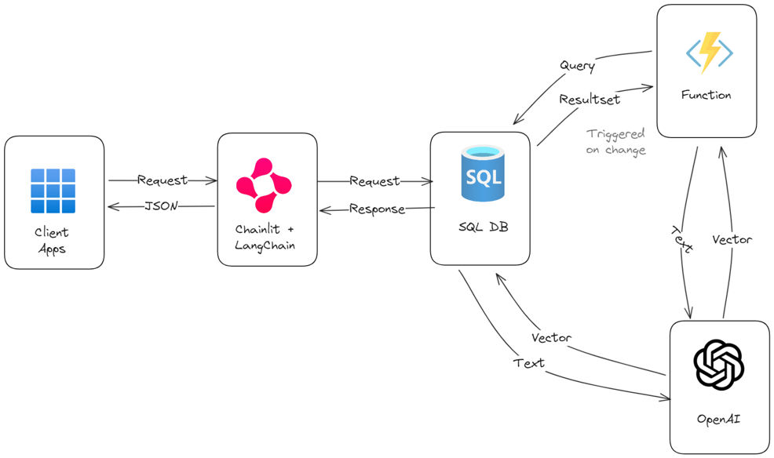
End-to-end scenario – Chatbot on your Data
Blog https://devblogs.microsoft.com/azure-sql/build-a-chatbot-on-your-own-data-in-1-hour-with-azure-sql-langchain-and-chainlit/ Code
https://github.com/Azure-Samples/azure-sql-db-rag-langchain-chainlit

Slide 98

The Future of SQL and AI
Enhanced Azure AI Services experiences.
Enhanced vector support
Simpler T-SQL for RAG patterns
Deeper integration with AI frameworks
New and enhanced Copilots experiences
SQL and AI ground to cloud
New SQL Fabric experiences

Slide 99
Resources
Try Azure SQL Database free of charge
SQL AI Workshop
aka.ms/sqlaiworkshop
SQL AI Docs
aka.ms/sqlai
SQL AI samples
aka.ms/sqlaisamples
SQL Copilots
aka.ms/sqlcopilot
Videos from our team
aka.ms/dataexposed
aka.ms/sql_db_essentials
Vector private preview signup aka.ms/azuresql-vector-eap
Get 100,000 vCore seconds of compute and 32 GB of storage every month!
What’s included:
One Azure SQL Database per Azure subscription with 100,000 vCore seconds compute every month
32 GB data storage +
32 GB backup storage
aka.ms/freedboffer
Notes:
Bob

